Slide 1


Mental Health
Mental health is a state of mental well-being that enables people to cope with the stresses of life, realize their abilities, learn well and work well, and contribute to their community

Slide 2
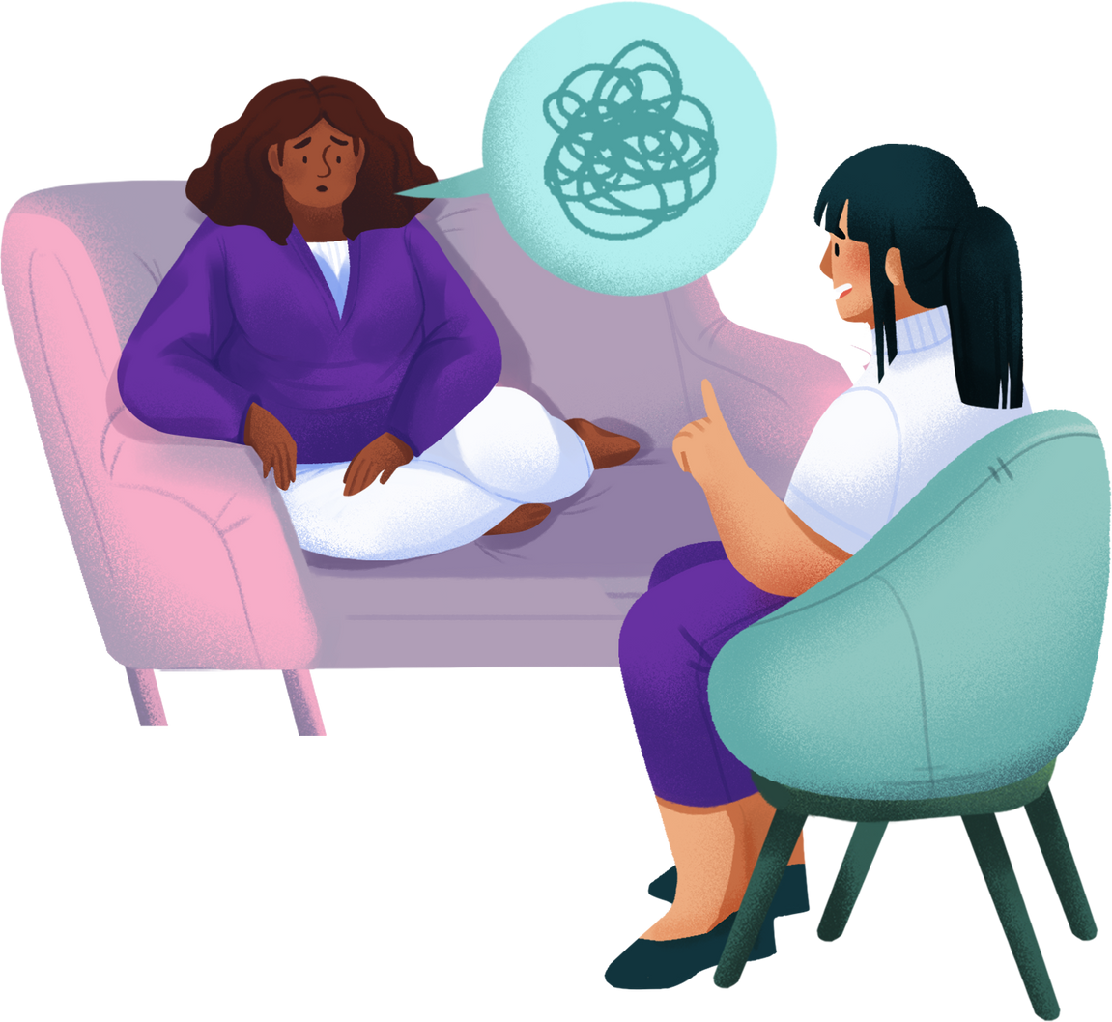
Title:
"Mental Health Assistant: A Holistic Approach“ :-In this era of advancing technology and increasing awareness of mental health issues, a holistic approach to mental health care has become increasingly important.

Slide 3

2: Introduction
Brief overview of the importance of mental health support :-Overall Well-being: Mental health support promotes emotional, psychological, and social well-being, leading to a higher quality of life and improved overall health.

Slide 4

3: Objectives
List the main goals of the app:
Personalized mood tracking and journaling.
Guided relaxation and mindfulness exercises.
Connection to mental health professionals and support groups.

Slide 5
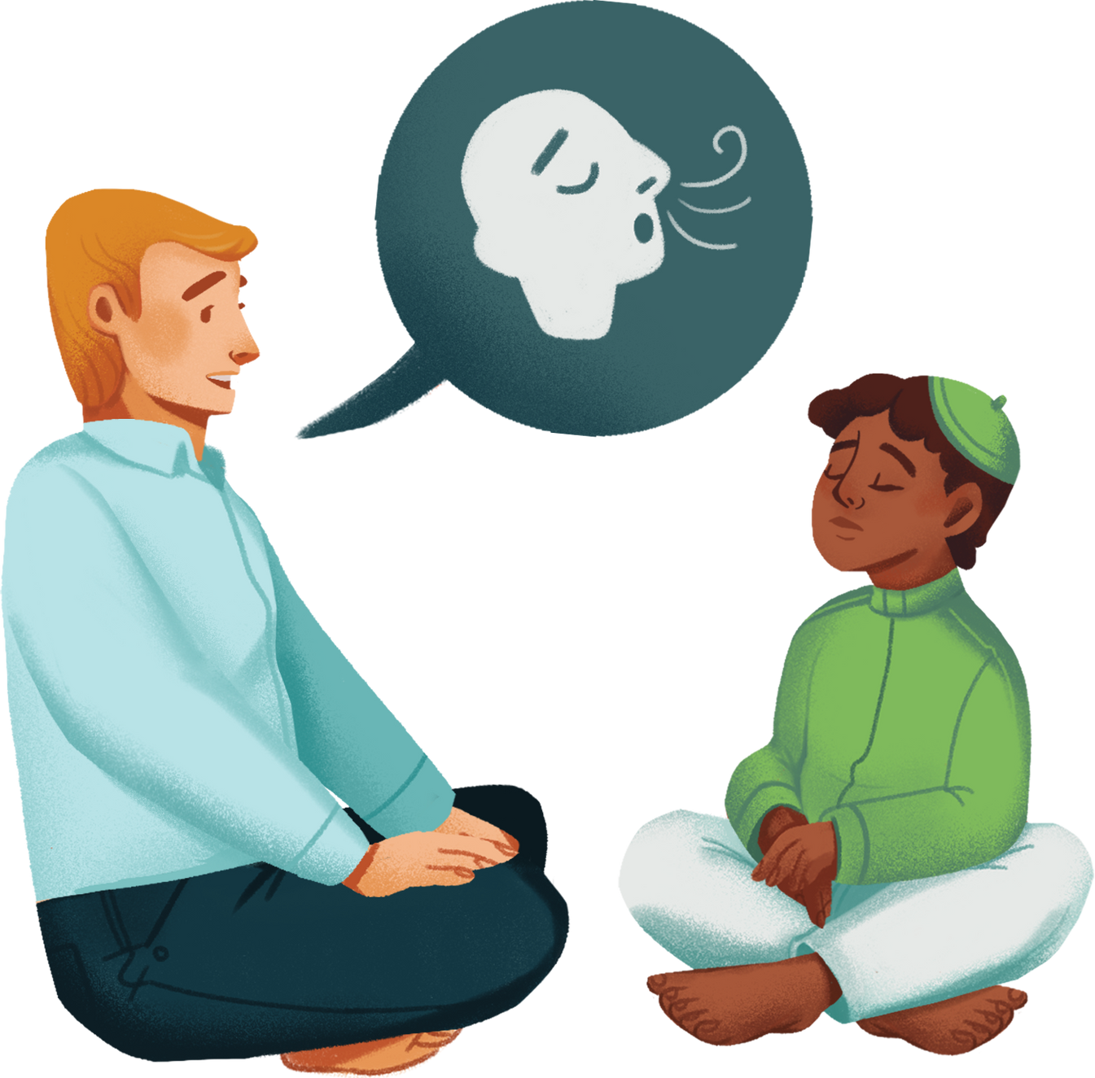
4: Personalized Mood Tracking
Highlight features for mood tracking and journaling:- The Mental Health Assistant app offers robust features for mood tracking and journaling, empowering users to gain insights into their emotions .

Slide 6

5: Guided Relaxation Mindfulness .
Showcase various exercises available in the app:- The Mental Health Assistant app offers a variety of exercises designed to promote self-awareness, mindfulness.

Slide 7
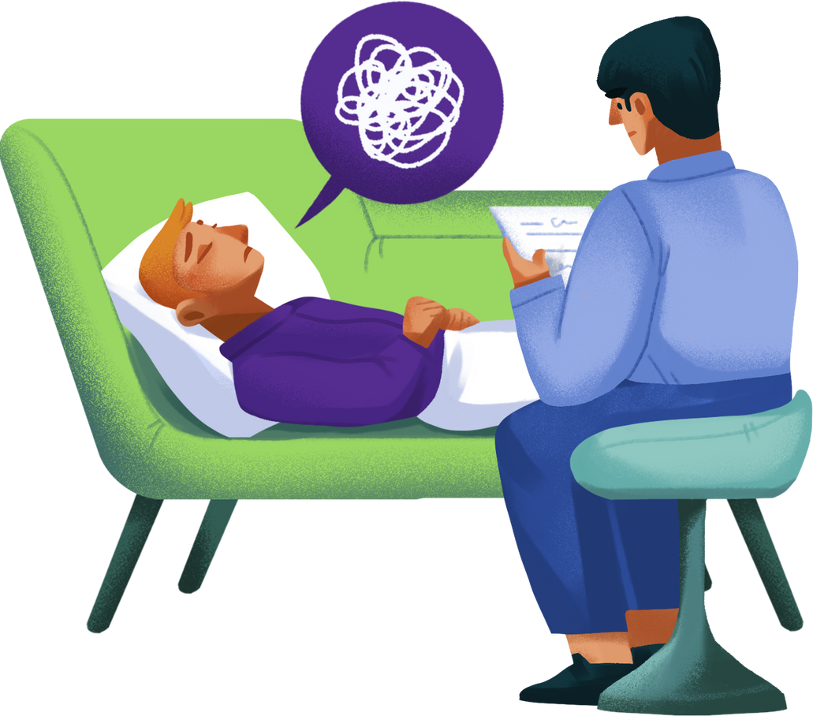
6: Connection to Professionals
Describing the app’s feature connecting users with mental health professionals:- The Mental Health Assistant app includes a feature that connects users with mental health professionals.

Slide 8

7: Support Groups
Highlighting the app’s ability to connect users with support groups:-
The Mental Health Assistant app offers a valuable feature that connects users with support groups.

Slide 9

8: user interface
•Display screenshots of the app's user interface
•Emphasize user-friendly design and accessibility features

Slide 10

9: Security and Privacy
Discuss measures taken to ensure user data security and privacy:- All data transmitted between the app and its servers is encrypted using strong encryption protocols (e.g., SSL/TLS) .

Slide 11

10: Testimonials
Showcase positive user testimonials (if available);-
As an AI, I don't have access to real user testimonials from the Mental Health Assistant app. However.

Slide 12

11: Future Developments
Mention plans for future updates and improvements
Invite user feedback for continuous enhancement

Slide 13

12: Conclusion
Recap key features and benefits of the Mental Health Assistant app:- The app provides personalized recommendations, interventions, and resources based on each user's unique needs, preferences, and goals.

Slide 14



THANK YOU
From the bottom of our hearts, thank you for being a part of our project.

